Slide 1
COMP9024: Data Structures and Algorithms
Graphs (I)

Slide 2
Contents
Graph terminology
Adjacency matrix representation
Adjacency list representation

Slide 3
Graphs
1843
ORD
SFO
802
337
1743
LAX
1233
DFW

Slide 4
Graphs
A graph is a pair (V, E), where
V is a set of nodes, called vertices
E is a collection of pairs of vertices, called edges
Vertices and edges are positions and store elements
Example:
A vertex represents an airport and stores the three-letter airport code
An edge represents a flight route between two airports and stores the mileage of the route
849
PVD
1843
ORD
142
SFO
802
LGA
337
1743
1387
HNL
2555
1099
LAX
1233
DFW
1120
MIA

Slide 5
Edge Types
Directed edge
ordered pair of vertices (u,v)
first vertex u is the origin
second vertex v is the destination
e.g., a flight
Undirected edge
unordered pair of vertices (u,v)
e.g., a flight route
Directed graph
all the edges are directed
e.g., route network
Undirected graph
all the edges are undirected
e.g., flight network
flight
AA 1206
ORD
PVD
849
miles
ORD
PVD

Slide 6
Applications
Electronic circuits
Printed circuit board
Integrated circuit
Transportation networks
Highway network
Flight network
Computer networks
Local area network
Internet
Web
Databases
Entity-relationship diagram

Slide 7
Terminology (1/5)
End vertices (or endpoints) of an edge
U and V are the endpoints of a
Edges incident on a vertex
a, d, and b are incident on V
Adjacent vertices
U and V are adjacent
Parallel edges
h and i are parallel edges
Self-loop
j is a self-loop
V
a
b
h
j
U
d
X
Z
c
e
i
W
g
f
Y

Slide 8
Terminology (2/5)
Path
sequence of alternating vertices and edges
begins with a vertex
ends with a vertex
each edge is preceded and followed by its endpoints
Simple path
path such that all its vertices and edges are distinct
Examples
P₁=(V,b,X,h,Z) is a simple path
P₂=(U,c,W,e,X,g,Y,f,W,d,V) is a path that is not simple
V
a
b
P₁
d
U
X
Z
P₂
h
c
e
W
g
f
Y

Slide 9
Terminology (3/5)
Cycle
circular sequence of alternating vertices and edges
each edge is preceded and followed by its endpoints
Simple cycle
cycle such that all its vertices and edges are distinct
Examples
C₁=(V,b,X,g,Y,f,W,c,U,a,↵) is a simple cycle
C₂=(U,c,W,e,X,g,Y,f,W,d,V,a,↵) is a cycle that is not simple
V
a
b
d
U
X
Z
C₂
h
e
C₁
c
W
g
f
Y

Slide 10
Terminology (4/5)
V
Degree of a vertex in an undirected graph
The number of edges
for example, the degree of V is 3
Indegree (outdegree) of a vertex (directed graph)
The number of incoming (outgoing) edges
For example, the indegree of V is 3 and its out degree is 0
a
b
d
U
X
Z
h
e
c
W
V
a
b
d
U
X
Z
h
e
c
W

Slide 11
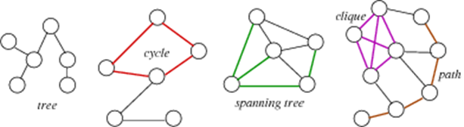
Terminology (5/5)
Tree: connected graph with no cycles
Spanning tree: tree containing all vertices
Clique: complete subgraph

Slide 12
Properties
Property 1
Σ_{v} deg(v) = 2m
Proof: each edge is counted twice
Property 2
In an undirected graph with no self-loops and no multiple edges
m ≤ n (n − 1)/2
Proof: each vertex has degree at most (n − 1)
What is the bound for a directed graph?
Notation
n number of vertices
m number of edges
deg(v) degree of vertex v
Example
n = 4
m = 6
deg(v) = 3

Slide 13
Graph Representations
Adjacency lists
Adjacency matrix
Both representations map vertices into integers in [0, n-1], where n is the number of vertices.

Slide 14
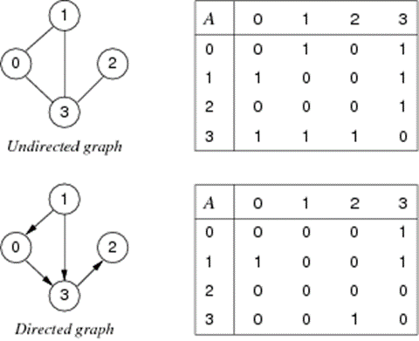
Adjacency matrix (1/8)
Edges represented by a n × n matrix

Slide 15
Adjacency matrix (2/8)
Advantages
easily implemented as 2-dimensional array
can represent graphs, digraphs and weighted graphs
undirected graphs: symmetric boolean matrix
digraphs (directed graphs): non-symmetric boolean matrix
weighted graphs: non-symmetric matrix of weight values
Disadvantages:
if few edges (sparse) ⇒ memory-inefficient

Slide 16
Adjacency matrix (3/8)
Graph initialization
newGraph(n):
Input: number of nodes n
Output: new empty graph
g.nV = n;
g.nE = 0;
allocate memory to g.edges[][]
for all i,j=0…n-1 do
g.edges[i][j]=0;
return g;

Slide 17
Adjacency matrix (4/8)
Edge insertion
insertEdge(g,(v,w))
Input: graph g, edge (v,w)
if ( g.edges[v][w]= 0 )
{ g.edges[v][w]=1;
g.edges[w][v]=1;
g.nE=g.nE+1;
}

Slide 18
Adjacency matrix (5/8)
Edge removal
removeEdge(g,(v,w))
Input graph g, edge (v,w)
if ( g.edges[v][w]≠0)
{
g.edges[v][w]=0;
g.edges[w][v]=0;
g.nE=g.nE-1;
}

Slide 19
Adjacency matrix (6/8)
Write an algorithm to output all edges of an undirected graph (no duplicates!)
show(g)
Input: graph g
for all i=0 to g.nV-1 do
for all j=i+1 to g.nV-1 do
if ( g.edges[i][j]≠0 )
print i"—"j;

Slide 20
Adjacency matrix (7/8)
Space complexity: O(n²)
if a graph is sparse, most storage is wasted.
Time complexity:
initialisation: O(n²) (initialise n×n matrix)
insert an edge: O(1) (set two cells in matrix)
delete an edge: O(1) (unset two cells in matrix)

Slide 21
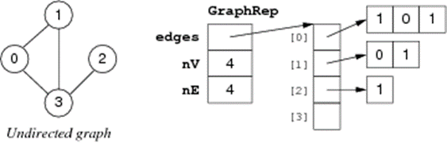
Adjacency matrix (8/8)
A space optimisation for undirected graphs: store only top-right part of matrix.
New space complexity:
n-1 int ptrs + n(n-1)/2 ints (but still O(n²))
Requires us to always use edges (v, w) such that v < w.

Slide 22
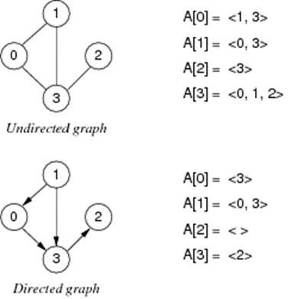
Adjacency List (1/6)
For each vertex, store a linked list of adjacent vertices:

Slide 23
Adjacency List (2/6)
Advantages
relatively easy to implement in languages like C
memory efficient if E:V relatively small
Disadvantages:
one graph has many possible representations unless lists are ordered by same criterion e.g. ascending

Slide 24
Adjacency List (3/6)
Graph initialization
newGraph(n)
Input: number of nodes n
Output: new empty graph
g.nV = n;
g.nE = 0;
allocate memory for g.edges[];
for all i=0..n-1 do
g.edges[i]=NULL;
return g

Slide 25
Adjacency List (4/6)
Edge insertion
insertEdge(g,(v,w))
Input: graph g, edge (v,w)
if ( inLL(g.edges[v],w) ) // inLL(g.edges[v],w) checks if w is in g.edges[v]
{ insertLL(g.edges[v],w); // insertLL(g.edges[v],w) inserts w into g.edges[v]
insertLL(g.edges[w],v);
g.nE=g.nE+1;
}

Slide 26
Adjacency List (5/6)
Edge removal
removeEdge(g,(v,w))
Input: graph g, edge (v,w)
if ( inLL(g.edges[v],w) )
{
deleteLL(g.edges[v],w); // deleteLL(g.edges[v],w) deletes w from g.edges[v]
deleteLL(g.edges[w],v);
g.nE=g.nE-1;
}
inLL, insertLL, deleteLL are standard linked list operations

Slide 27
Adjacency List (6/6)
Analyse space complexity and time complexity of adjacency list representation:
Space complexity: O(n+m), where m is the number of edges
Time complexity:
initialisation: O(n) (initialise n lists)
insert an edge: O(1) for unsorted lists (insert one vertex into one list (digraph) or two lists (undirected graph)) if don't check for duplicates
delete edge: O(degree(v)+degree(w))=O(m) (need to delete incident vertex from two lists)
If vertex lists are sorted
insertion requires search of list ⇒ O(m)
deletion always requires a search, regardless of list order

Slide 28
Comparison of Graph Representations

Slide 29
Graph Abstract Data Type (1/2)
Data:
set of edges, set of vertices
Operations:
insertion: create graph, add edge
deletion: remove edge, delete whole graph
search: check if graph contains a given edge
Things to note:
the set of vertices is fixed when a graph is initialised
we treat vertices as ints, but could be arbitrary Items

Slide 30
Graph Abstract Data Type (2/2)
Graph ADT interface graph.h
typedef struct GraphRep *Graph;
typedef int Vertex;
typedef struct Edge { Vertex v; Vertex w; } Edge;
Graph newGraph(int V);
void insertEdge(Graph, Edge);
void removeEdge(Graph, Edge);
bool adjacent(Graph, Vertex, Vertex);
void freeGraph(Graph);

Slide 31
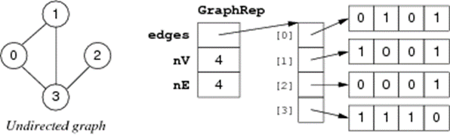
Graph Implementation with Adjacency Matrix (1/4)
Implementation of GraphRep (adjacency-matrix representation)
typedef struct GraphRep {
int **edges;
int nV;
int nE;
} GraphRep;

Slide 32
Graph Implementation with Adjacency Matrix (2/4)
Implementation of graph initialisation (adjacency-matrix representation)
Graph newGraph(int n) {
assert(n >= 0);
int i;
Graph g = malloc(sizeof(GraphRep)); // allocate heap memory to g
assert(g != NULL); g->nV = n; g->nE = 0;
g->edges = malloc(n * sizeof(int *)); // allocate heap memory to g->edges
assert(g->edges != NULL);
for (i = 0; i < n; i++) { // allocate heap memory to g->edges[i]
g->edges[i] = calloc(n, sizeof(int)); assert(g->edges[i] != NULL);
}
return g;
}

Slide 33
Graph Implementation with Adjacency Matrix (3/4)
Implementation of edge insertion/removal (adjacency-matrix representation)
bool validV(Graph g, Vertex v)
{ return (g != NULL && v >= 0 && v < g->nV);}
void insertEdge(Graph g, Edge e) {
assert(g != NULL && validV(g,e.v) && validV(g,e.w));
if (!g->edges[e.v][e.w]) {
g->edges[e.v][e.w] = 1; g->edges[e.w][e.v] = 1; g->nE++; }}
void removeEdge(Graph g, Edge e) {
assert(g != NULL && validV(g,e.v) && validV(g,e.w));
if (g->edges[e.v][e.w]) {
g->edges[e.v][e.w] = 0; g->edges[e.w][e.v] = 0; g->nE--; }}

Slide 34
Graph Implementation with Adjacency Matrix (4/4)
Implement a function to check whether two vertices are directly connected by an edge
bool adjacent(Graph g, Vertex x, Vertex y) {
assert(g != NULL && validV(g,x) && validV(g,y));
return (g->edges[x][y] != 0);
}

Slide 35
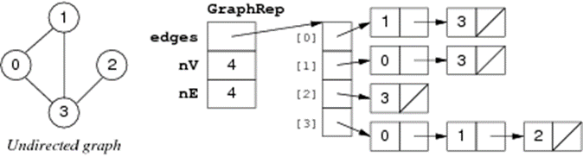
Graph Implementation with Adjacency Lists (1/7)
Implementation of GraphRep (adjacency-list representation)
typedef struct GraphRep {
Node **edges;
int nV;
int nE;
} GraphRep;
typedef struct Node {
Vertex v;
struct Node *next;
} Node;

Slide 36
Graph Implementation with Adjacency Lists (2/7)
Implementation of graph initialisation (adjacency-list representation)
Graph newGraph(int n) {
int i;
assert(n >= 0);
Graph g = malloc(sizeof(GraphRep));
assert(g != NULL);
g->nV = n; g->nE = 0;
g->edges = malloc(nV * sizeof(Node *));
assert(g->edges != NULL);
for (i = 0; i < n; i++)
g->edges[i] = NULL;
return g;
}

Slide 37
Graph Implementation with Adjacency Lists (3/7)
Implementation of edge insertion/removal (adjacency-list representation)
void insertEdge(Graph g, Edge e) {
assert(g != NULL && validV(g,e.v) && validV(g,e.w));
if (!inLL(g->edges[e.v], e.w)) {
g->edges[e.v] = insertLL(g->edges[e.v], e.w);
g->edges[e.w] = insertLL(g->edges[e.w], e.v);
g->nE++;
}
}

Slide 38
Graph Implementation with Adjacency Lists (4/7)
void removeEdge(Graph g, Edge e) {
assert(g != NULL && validV(g,e.v) && validV(g,e.w));
if (inLL(g->edges[e.v], e.w)) {
g->edges[e.v] = deleteLL(g->edges[e.v], e.w);
g->edges[e.w] = deleteLL(g->edges[e.w], e.v);
g->nE--;
}
}
inLL, insertLL, deleteLL are standard linked list operations

Slide 39
Graph Implementation with Adjacency Lists (5/7)
Assuming an adjacency list representation, implement a function to check whether two vertices are directly connected by an edge
bool adjacent(Graph g, Vertex x, Vertex y) {
assert(g != NULL && validV(g,x));
return inLL(g->edges[x], y);
}

Slide 40
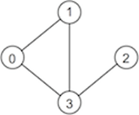
Graph Implementation with Adjacency Lists (6/7)
Write a program that uses the graph ADT to
build the graph depicted below
print all the nodes that are incident to vertex 1 in ascending order

Slide 41
Graph Implementation with Adjacency Lists (7/7)
#include <stdio.h>
#include "Graph.h"
#define NODES 4
#define NODE_OF_INTEREST 1
int main(void) {
Graph g = newGraph(NODES); Edge e; int i;
e.v = 0; e.w = 1; insertEdge(g,e);
e.v = 0; e.w = 3; insertEdge(g,e);
e.v = 1; e.w = 3; insertEdge(g,e);
e.v = 3; e.w = 2; insertEdge(g,e);
for (i = 0; i < NODES; i++) {
if (adjacent(g, i, NODE_OF_INTEREST))
printf("%d\n", i);}
freeGraph(g);
return 0; }

Slide 42
Summary
Graph terminology
vertices, edges, vertex degree, connected graph, tree
path, cycle, clique, spanning tree, spanning forest
Graph representations
adjacency matrix
adjacency lists
Suggested reading:
Sedgewick, Ch.17.1-17.5

